Slide 1

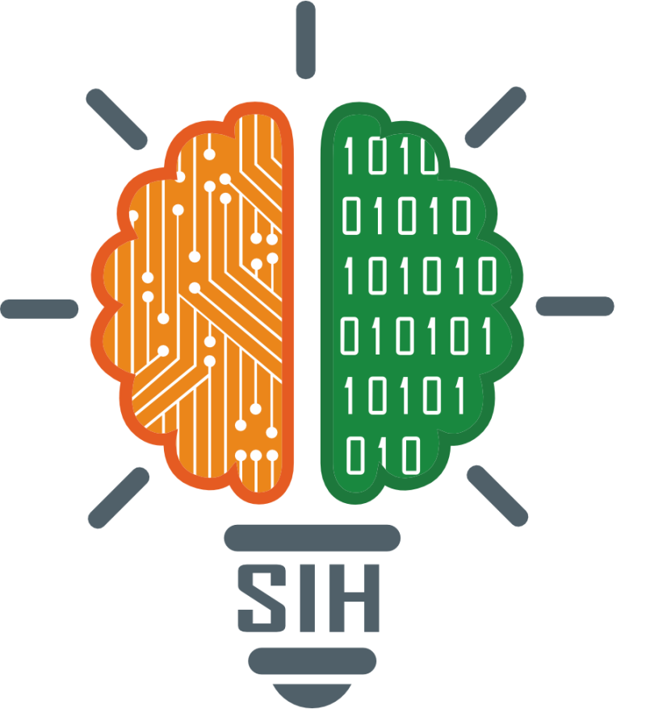
SMART INDIA HACKATHON 2024
Problem Statement ID – SIH1554
Problem Statement Title- Smart Irrigation System for Precision Farming
Theme- Agriculture, Food Tech & Rural Development
PS Category- Hardware
Team ID-
Team Name (Registered on portal)

Slide 2


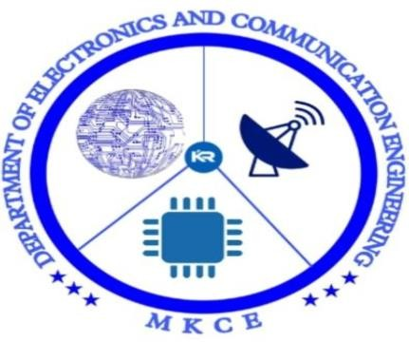
DEPARTMENT OF ELECTRONICS AND COMMUNICATION ENGINEERING
AGRO AQUAS
PROBLEM STATEMENT :
SMART IRRIGATION SYSTEM FOR PRECISION FARMING
GUIDED BY :
Mrs.S.NIVISHNA., M.E
TEAM MATES :
INDRAJITH U K
MANOJ KUMAR K
HARISH P
(927622BEC074)
(927622BEC113)
(927622BEC304)

Slide 3
PROPOSED SYSTEM
The moisture sensor wirelessly transmits data to the Arduino Uno via a Bluetooth module.
Based on the field data, the Arduino checks the weather report using a weather prediction module and communicates with the well's water level sensor.
If the water level in the well is low, the Arduino sends a signal to the borewell water level sensor.
If the borewell has enough water, the borewell motor automatically turns on to pump water into the well.
Once the well reaches its threshold water level, the well motor activates, and a Bluetooth-integrated wireless valve opens according to the moisture sensor's data.
When the moisture level in the field reaches the threshold, the valve automatically closes, and the pump shuts off.
A pressure monitoring sensor is integrated into the valve, and all data is transmitted to a mobile application via IoT for real-time monitoring.

Slide 4
TECHNICAL APPROACH
Bluetooth Integrated Wireless Moisture Sensor
Weather Prediction Module
Micro Controller
( Arduino Uno)
LCD and IoT
Power Supply
Bore Well and Well Motor Setup
Field
Bluetooth Integrated Wireless Valve

Slide 5
FEASIBILITY AND VIABILITY
Wireless data transmission between the moisture sensor and Arduino Uno via Bluetooth is achievable, while weather prediction modules can be integrated for real-time forecasts.
Water level sensors and motorized pumps for both the well and borewell are commercially available, as are IoT modules for mobile app integration.
However, the project requires precise programming for automation, stable Bluetooth and IoT connectivity, and reliable sensors to prevent malfunction.
Overall, with careful execution, this project can efficiently manage water resources and improve agricultural outcomes.

Slide 6
IMPACT AND BENEFITS
This smart irrigation system project optimizes water usage and improves crop yield by automating water distribution based on real-time soil moisture, weather conditions, and water levels in wells and borewells.
By minimizing water waste and ensuring crops receive the right amount of water, it promotes sustainable agriculture.
The integration of IoT allows farmers to monitor and control the system remotely via a mobile application, providing convenience and enhancing decision-making.
This system reduces manual labor, prevents over-irrigation, and helps conserve water, making it highly beneficial for areas facing water scarcity or aiming for efficient resource management.

Slide 7
RESEARCH AND REFERENCES
[1] "Smart Irrigation System Using Bluetooth" by IJARCCE (International Journal of Advanced Research in Computer Engineering & Technology).
[2] "Automatic Irrigation System Using Bluetooth" by IRJET (International Research Journal of Engineering and Technology).
[3] "Smart Irrigation System Based on Bluetooth" by IJSRD (International Journal of Scientific Research and Development).
[4] "Bluetooth-Based Smart Irrigation System" by IEEE (Institute of Electrical and Electronics Engineers).
[5] "Smart Irrigation System Using Bluetooth and Arduino" by Instructables .
[6] "Automatic Irrigation System Using Bluetooth and Raspberry Pi" by Hackster .

